Slide 1
Linked Lists
A linked list is a group of nodes.
Each node contains a value and a
reference to the next node in
the list.

Slide 2
Simple Node Class
public class Node
{
private Comparable data;
private Node next;
public Node(Comparable dat, Node nxt)
{
data=dat;
next=nxt;
}
}

Slide 3
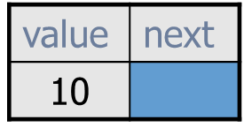
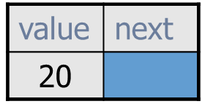
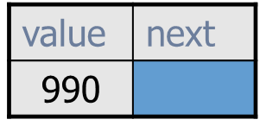
Typical Linked List
list is a reference variable that stores a reference to the first node. It does not store 10!
Each node stores a value AND a reference to the node that follows it.
list
...
A more streamlined representation:
10
20
990
list
...

Slide 4
A Single Node
0xF2
node
B
null
0xF2
A node typically has a data
component and a reference
to the next node.

Slide 5
Some draw the null reference this way!
0xF2
node
B
null
0xF2
This leads to the misconception that the “B” node points to a node that stores a null value, but there simply is no node after the “B” node.

Slide 6
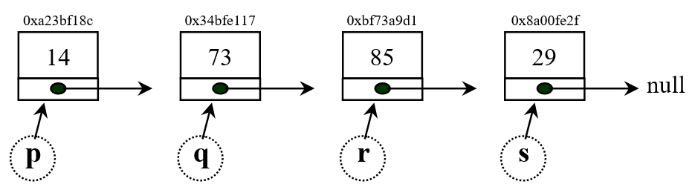
Directions: Show what the following commands do to the given diagram of a linked list. Draw an arrow to demonstrate the result of the command.
s = q.getNext();
Notes:
s originally stored a link to the 29 node (i.e. the node object that stores a value of 29).
Now s stores a link to the 85 node.

Slide 7

Directions: Show what the following commands do to the given diagram of a linked list. Draw an arrow to demonstrate the result of the command.
s.setNext(q.getNext());
Notes:
s originally stored a link to the 29 node (i.e. the node object that stores a value of 29).
Now s stores a link to the 85 node.

